Slide 1
CSE 470 Quality Assurance
Week 09 Quality Maturity

Slide 2
5. QA Processes
(V&V, Reviews, Audits)
8. Reviews & Audits
(Tech, Mngt., Inspection, walk-throughs, checklist)
10. Configuration Management
1. Fundamentals & Business Case for Quality Assurance
(IEEE SWBok)
9. Maturity
(CMM, Process, Product, ISO)
11. Risk/Mission Assurance
(Training, CAR, Mitigation)
6. QA Tools
(Fishbone, check, Histograms, Pareto, Scatter, Stratification)]
12. Security/ Legal/ Ethics
(Regulations, Code, Legal, Safety)
2. QA’s Role in SW Lifecycle, Methodologies,
Architecture
[Responsibilities & Roles]
7. QA Attributes
(Verification and Validation )
13 . Project Management
(CoQ, WBS, DevOps )
[VDD, Version, DM, DI]
14. Careers Path
3. QA Techniques
(Dyn, Static, and Testing)
[]
4. Quality Metrics
(Characteristic & Models)
[Measuring]
Know
Do
Become
SWE 474: Quality Assurance Class

Slide 3
Agenda
Overview of Quality Maturity
Assignments
What is involved in CMM audit?
What is involved in a ISO 9001 audit?
Update SQAP Section 3: Management and 11: Supplier Control

Slide 4
Reading
L. Westfall Certified Software Quality Engineer Handbook, ASQ Quality Press, 2009-09-01, Chapter 7.2-7.3: Methodologies (for Quality Management) (pages 6)
2. Process Improvement Models
SWEBOK: Appendix B: Software Quality (B-20) (pages 1) M. Paulk et al., "Capability Mature Model for Software, Version 1.1," Chapter 1-3 IEEE Software, vol. 10, no. 4, pp. 18-27, Jul. 1993. (pages 10)
M. Paulk et al., "Key Practices of the Capability Mature ModelSM, Version 1.1," Technical Report CMU/SEI-93-TR-025, Feb. 1993. Read sections
Level 2: Software Quality Assurance page 153-164 (page 11)
Level 2: Software Subcontract Management 135-151 (pages 16)
Level 3: Peer Reviews (284-297) (pages 13)
Level 4: Quantitative Process Management (299-316) (pages 17)
Level 4: Software Quality Management (317-333) (pages 16)
Level 5: Defect Prevention (334-351) (page 17)

Slide 5
Reading
90003-2018 - ISO/IEC/IEEE International Standard - Software engineering -- Guidelines for the application of ISO 9001:2015 to computer software Read Instruction, and when applicable Section 6-10 ( pg 23-62)
Six Sigma Approach in Software Quality Improvement CMMI and Six Sigma-Relationship&Integration

Slide 6
Overview

Slide 7
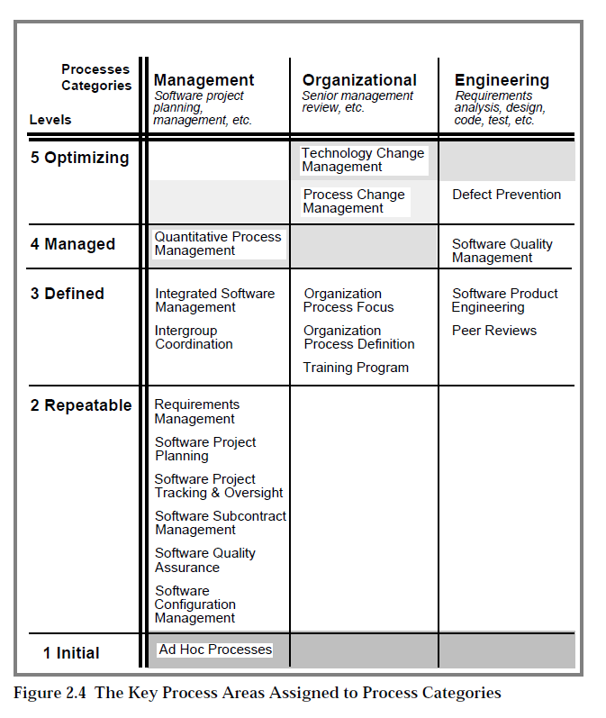
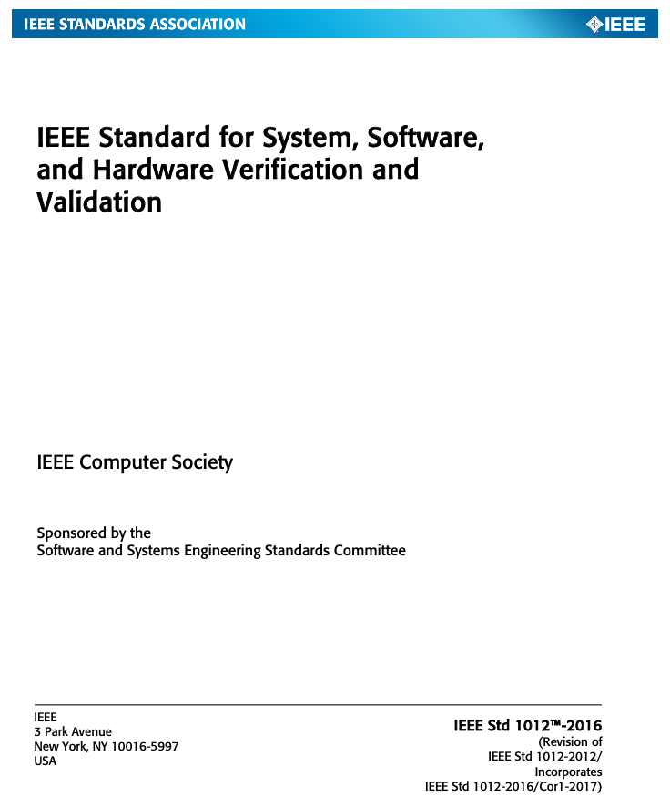
What is involved in CMM audit?
For this week we are going to audit the IEEE 1012-2016 with the CMM Level 2-4.
Based on the V&V Process Phases from the IEEE 1012-2016 document, go through each CMM Activity listed below: CMM
Level 2
Software Quality Assurance Activities: 8
Software Subcontract Management Activities: 13
Level 3
Peer Reviews Activities: 3
Level 4
Quantitative Process Management Activities: 7
Software Quality Management Activities: 5
Level 5
Defect Prevention Activities: 8
And complete the following:
Part 1: CMM Activity Category
Identify each CMM activity (not the goal, commitment, ability). Summarize the suggested activities.
Determine which category the activity belongs:
Plan & Design
Execution
Test Case & Procedure
Revise
Part 2: CMM vs IEEE V&V
For each CMM Activity, identify one activity in the IEEE V&V process that would demonstrate that the CMM Activity is being completed.
Level 2
Software Quality Assurance
Level 3
Peer Reviews
Level 4
Quantitative Process Management
Software Quality Management
Level 5
Defect Prevention
Plan & Design
Execute
Test &Procedure
Revise

Slide 8

Prove: Complete SQAP Section 7: Tests
 | V&V Process Phases
 | Plan | Design | Test Case | Procedure | Execution
V&V Processes
Qualification | Requirements | Design | Construction | Construction | Qualification
Acceptance | Requirements | Design | Construction | Acceptance | Acceptance
Integration | Design | Design | Construction | Construction | Integration
Component | Design | Design | Construction | Construction | Construction
Use Process to Determine the Sections and preliminary content
Component Test Plan V&V
Component Test Design V&V
Component Test Case V&V
Component Test Procedures V&V
Component Execution V&V
7 Tests
Description
7.1 Test Planning
7.2 Test Design
7.3 Test Cases
7.4 Test Procedures
7.5 Test Execution
Add more content with SQ Eng Chapter 22
1. Test Strategies
2. Test Plans
3. Test Designs
4. Software Tests
5. Tests of Supplier Component & Product (Week
6. Test Coverage Specifications
7. Code Coverage Techniques
8. Test Environments
9. Test Tools

Slide 9
Plan & Design
Participate, Initiated
Prepare, Documented
Test & procedure
Collect & Documented Results
Analysis, compare
Execution
Maintained
Performed & Conduct
Review and Coordinate
Tracked, Monitor
Revise
Revision (Org. & Proj)
Feedback of Status
Measured, Baselined
Reports
Participate, Uses
Reviewed
Defined, Develop
Plan & Design
Execute
Test &Procedure
Revise

Slide 10

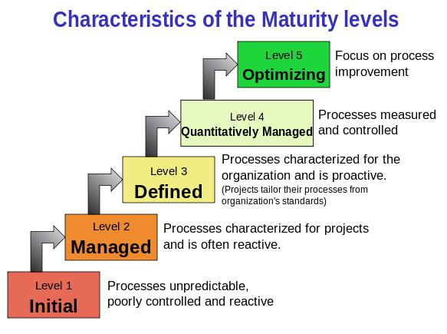
Overview of the Capability Maturity Model

Slide 11
Capability Mature Model for Software, Version 1.1 – Outline
IMMATURITY VERSUS MATURITY
Immaturity
Maturity
FUNDAMENTAL CONCEPTS
Five maturity levels
Behavioral characterization
Predicting performance
Skipping levels
CMM OPERATIONAL DEFINITION
Internal structure
Key process areas.
Goals
Common Features
Key Practices
FUTURE DIRECTIONS
Summary of Differences Between CMM Version 1.0 and Version 1.1
General Changes
Language Changes
Level 2 Changes
Level 3 Changes
Level 4 Changes
Level 5 Changes

Slide 12
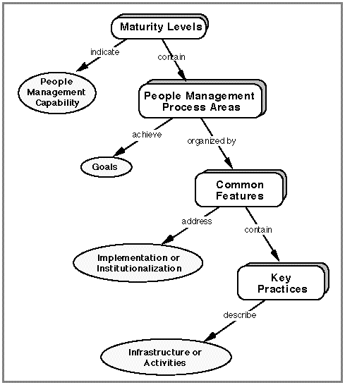
CMM OPERATIONAL DEFINITION
Internal structure
Key Process Areas
Common Features
Key process areas: Level 2-5
What are the different key process areas for each level?
(Next four slides)
Goals
Common Features
Key Practices

Slide 13
The key process areas at Level 2
Requirements Management p 91
Software Project Planning p 101
Software Project Tracking and Oversight p 121
Software Subcontract Management p 135
Software Quality Assurance p 153
Software Configuration Management p 165
Level 1->2: Ad Hoc to Process in place at Project Level

Slide 14
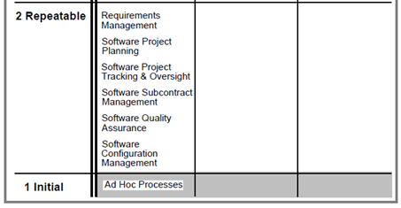
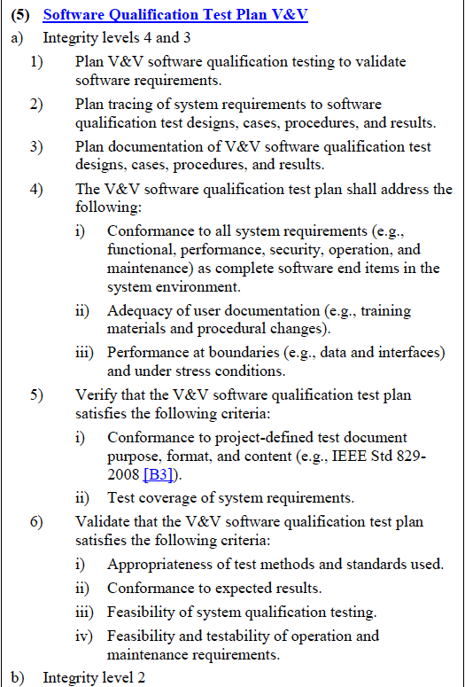
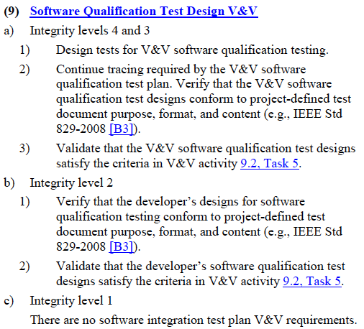
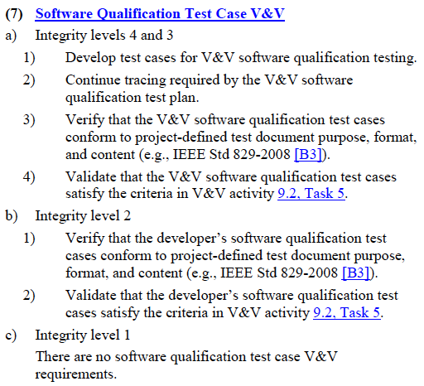
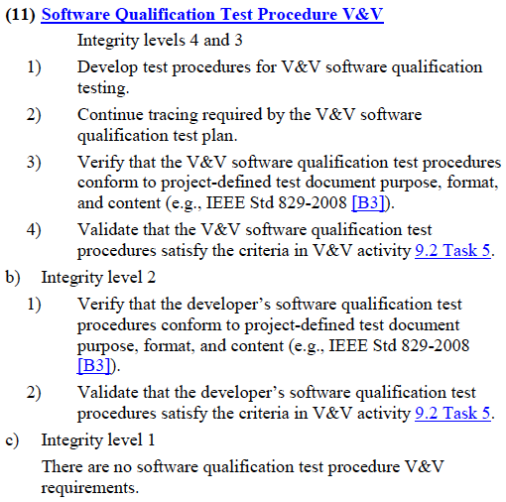
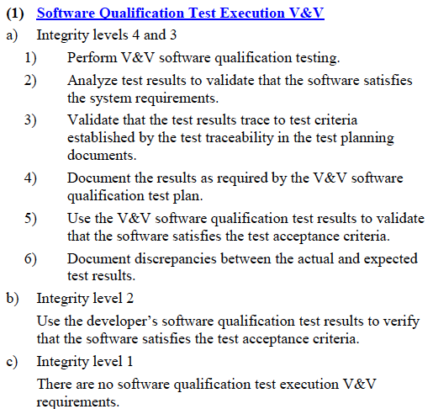
Software Quality Assurance (page 153)
Plan & Design
Execute
Test &Procedure
Revise
Activity 1 A SQA plan is prepared for the software project according to a documented procedure.
Activity 2 The SQA group's activities are performed in accordance with the SQA plan.
Activity 3 The SQA group participates in the preparation and review of the project's software development plan, standards, and procedures.
Activity 4 The SQA group reviews the software engineering activities to verify compliance.
Activity 5 The SQA group audits designated software work products to verify compliance.
Activity 6 The SQA group periodically reports the results of its activities to the software engineering group.
Activity 7 Deviations identified in the software activities and software work products are documented and handled according to a documented procedure.
Activity 8 The SQA group conducts periodic reviews of its activities and findings with the customer's SQA personnel, as appropriate.

Slide 15
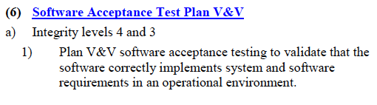
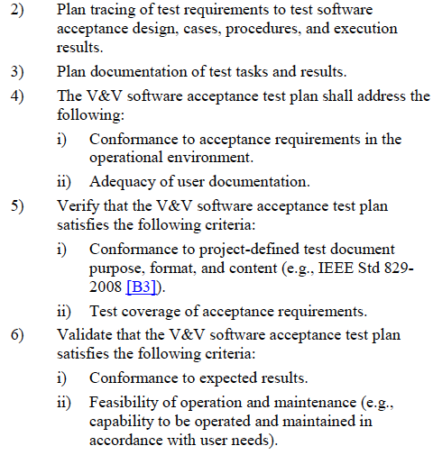
Requirement Management (page 91):
Plan & Design
Execute
Test &Procedure
Revise
Activity 1 The software engineering group reviews the allocated requirements before they are incorporated into the software project.
i.e. SPMP 5.3.1.3 Requirement Change control process
Activity 2 The software engineering group uses the allocated requirements as the basis for software plans, work products, and activities.
Activity 3 Changes to the allocated requirements are reviewed and incorporated into the software project.

Slide 16
Software Project Planning (page 101)
Plan & Design
Execute
Test &Procedure
Revise
Activity 1 The software engineering group participates on the project proposal team.
i.e. 5.1: Start-up plan
Activity 2 Software project planning is initiated in the early stages of, and in parallel with, the overall project planning.
Activity 3 The software engineering group participates with other affected groups in the overall project planning throughout the project's life.
Activity 4 Software project commitments made to individuals and groups external to the organization are reviewed with senior management according to a documented procedure.
Activity 5 A software life cycle with predefined stages of manageable size is identified or defined.
Activity 6 The project's software development plan is developed according to a documented procedure.
Activity 7 The plan for the software project is documented.
Activity 8 Software work products that are needed to establish and maintain control of the software project are identified.
Activity 9 Estimates for the size of the software work products (or changes to the size of software work products) are derived according to a documented procedure.
Activity 10 Estimates for the software project's effort and costs are derived according to a documented procedure.
Activity 11 Estimates for the project's critical computer resources are derived according to a documented procedure.
Activity 12 The project's software schedule is derived according to a documented procedure.
Activity 13 The software risks associated with the cost, resource, schedule, and technical aspects of the project are identified, assessed, and documented.
Activity 14 Plans for the project's software engineering facilities and support tools are prepared.
Activity 15 Software planning data are recorded.

Slide 17
Software Project Tracking and Oversight (page 121)
Plan & Design
Execute
Test &Procedure
Revise
Activity 1 A documented software development plan is used for tracking the software activities and communicating status.
Activity 2 The project's software development plan is revised according to a documented procedure.
Activity 3 Software project commitments and changes to commitments made to individuals and groups external to the organization are reviewed with senior management according to a documented procedure.
Activity 4 Approved changes to commitments that affect the software project are communicated to the members of the software engineering group and other software-related groups.
Activity 5 The size of the software work products (or size of the changes to the software work products) are tracked, and corrective actions are taken as necessary.
Activity 6 The project's software effort and costs are tracked, and corrective actions are taken as necessary.
i.e.: 5.3.3 Budget Control plan
Activity 7 The project's critical computer resources are tracked, and corrective actions are taken as necessary.
Activity 8 The project's software schedule is tracked, and corrective actions are taken as necessary.
Activity 9 Software engineering technical activities are tracked, and corrective actions are taken as necessary.
Activity 10 The software risks associated with cost, resource, schedule, and technical aspects of the project are tracked.
Activity 11 Actual measurement data and replanning data for the software project are recorded.
Activity 12 The software engineering group conducts periodic internal reviews to track technical progress, plans, performance, and issues against the software development plan.
Activity 13 Formal reviews to address the accomplishments and results of the software project are conducted at selected project milestones according to a documented procedure.

Slide 18
Software Configuration Management (page 165)
Plan & Design
Execute
Test &Procedure
Revise
Activity 1 A SCM plan is prepared for each software project according to a documented procedure.
7.1 Configuration Management plan
Activity 2 A documented and approved SCM plan is used as the basis for performing the SCM activities.
Activity 3 A configuration management library system is established as a repository for the software baselines
2.1 Reference
Activity 4 The software work products to be placed under configuration management are identified.
Activity 5 Change requests and problem reports for all configuration items/units are initiated, recorded, reviewed, approved, and tracked according to a documented procedure.
Activity 6 Changes to baselines are controlled according to a documented procedure.
i.e. 1.2 Evolution of plan
7.1 Configuration Management plan
Activity 7 Products from the software baseline library are created and their release is controlled according to a documented procedure.
Activity 8 The status of configuration items/units is recorded according to a documented procedure.
Activity 9 Standard reports documenting the SCM activities and the contents of the software baseline are developed and made available to affected groups and individuals.

Slide 19
Software Subcontract Management p 135
Plan & Design
Execute
Test &Procedure
Revise
Activity 1 The work to be subcontracted is defined and planned according to a documented procedure.
Activity 2 The software subcontractor is selected, based on an evaluation of the subcontract bidders' ability to perform the work, according to a documented procedure.
Activity 3 The contractual agreement between the prime contractor and the software subcontractor is used as the basis for managing the subcontract.
Activity 4 A documented subcontractor's software development plan is reviewed and approved by the prime contractor.
Activity 5 A documented and approved subcontractor's software development plan is used for tracking the software activities and communicating status.
Activity 6 Changes to the software subcontractor's statement of work, subcontract terms and conditions, and other commitments are resolved according to a documented procedure.
Activity 7 The prime contractor's management conducts periodic status/coordination reviews with the software subcontractor's management.
Activity 8 Periodic technical reviews and interchanges are held with the software subcontractor.
Activity 9 Formal reviews to address the subcontractor's software engineering accomplishments and results are conducted at selected milestones according to a documented procedure.
Activity 10 The prime contractor's software quality assurance group monitors the subcontractor's software quality assurance activities according to a documented procedure.
Activity 11 The prime contractor's software configuration management group monitors the subcontractor's activities for software configuration management according to a documented procedure.
Activity 12 The prime contractor conducts acceptance testing as part of the delivery of the subcontractor's software products according to a documented procedure.
Activity 13 The software subcontractor's performance is evaluated on a periodic basis, and the evaluation is reviewed with the subcontractor.

Slide 20
The key process areas at Level 3
Organization Process Focus p 188
Organization Process Definition p 198
Training Program p 212
Integrated Software Management p 223
Software Product Engineering p 246
Intergroup Coordination p 272
Peer Reviews p 284
Level 2->3: Process are used at Organizational Level

Slide 21
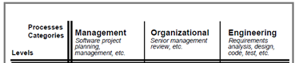
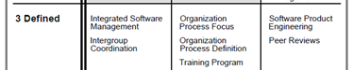
Training Program
Plan & Design
Execute
Test &Procedure
Revise
Goals:
Training activities are planned.
Training for developing the skills and knowledge needed to perform software management and technical roles is provided.
Individuals in the software engineering group and software related groups receive the training necessary to perform their roles.
Tools
Training Plan
Training Process
Training Requirements/Compliance DB
Training Log DB
Activity
Each software project develops and maintains a training plan that specifies its training needs
The organization's training plan is developed and revised according to a documented procedure
The training for the organization is performed in accordance with the organization's training plan.
Training courses prepared at the organization level are developed and maintained according to organization standards.
A waiver procedure for required training is established and used to determine whether individuals already possess the knowledge and skills required to perform in their designated roles.
Records of training are maintained

Slide 22
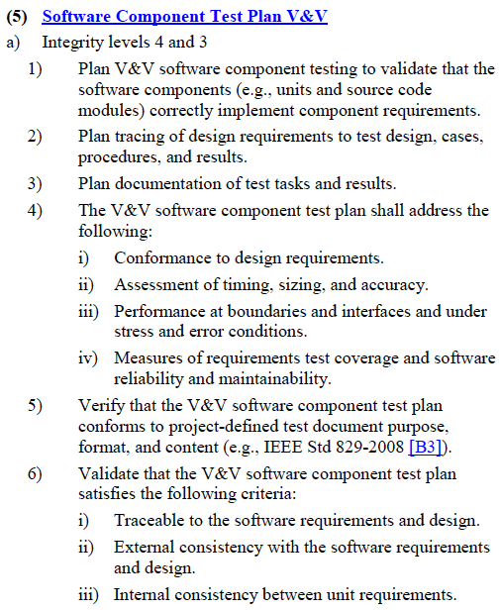
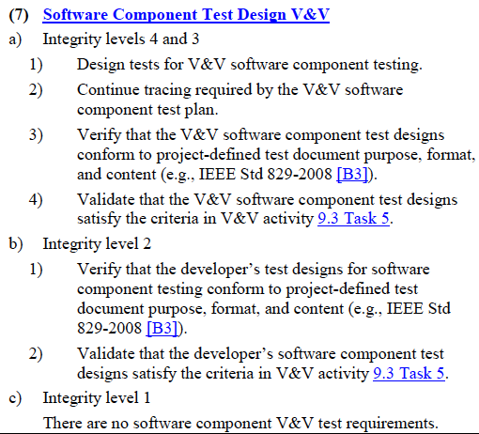
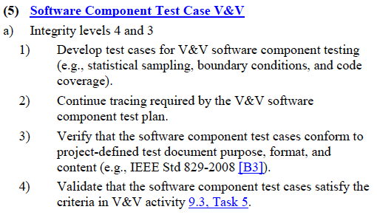
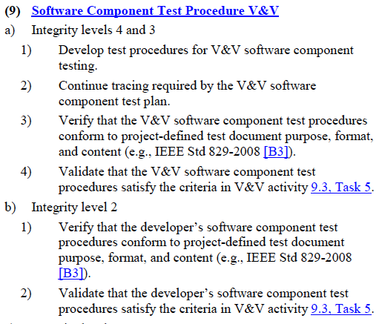
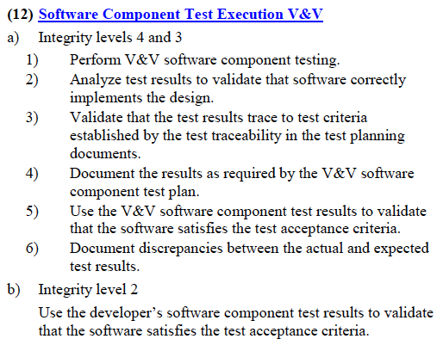
Peer Reviews
Plan & Design
Execute
Test &Procedure
Revise
Goals:
Peer review activities are planned.
Defects in the software work products are identified and removed.
Tools:
Reviews
Defect DB/ AI DB/ Backlog
Activities:
Peer reviews are planned, and the plans are documented
Peer reviews are performed according to a documented procedure.
Data on the conduct and results of the peer reviews are recorded

Slide 23
The key process areas at Level 4
Quantitative Process Management p 299
Software Quality Management p 317
Key Process Areas - ISO 9001
Level 3->4: Process & Products are Quality Control

Slide 24
Quantitative Process Management
Plan & Design
Execute
Test &Procedure
Revise
Activity 1 The software project's plan for quantitative process management is developed according to a documented procedure.
Activity 2 The software project's quantitative process management activities are performed in accordance with the project's quantitative process management plan.
Activity 3 The strategy for the data collection and the quantitative analyses to be performed are determined based on the project's defined software process.
Activity 4 The measurement data used to control the project's defined software process quantitatively are collected according to a documented procedure.
Activity 5 The project's defined software process is analyzed and brought under quantitative control according to a documented procedure.
Activity 6 Reports documenting the results of the software project's quantitative process management activities are prepared and distributed.
Activity 7 The process capability baseline for the organization's standard software process is established and maintained according to a documented procedure.

Slide 25
Software Quality Management
Plan & Design
Execute
Test &Procedure
Revise
Activity 1 The project's software quality plan is developed and maintained according to a documented procedure.
Activity 2 The project's software quality plan is the basis for the project's activities for software quality management.
Activity 3 The project's quantitative quality goals for the software products are defined, monitored, and revised throughout the software life cycle.
Activity 4 The quality of the project's software products is measured, analyzed, and compared to the products' quantitative quality goals on an event-driven basis.
Activity 5 The software project's quantitative quality goals for the products are allocated appropriately to the subcontractors delivering software products to the project.

Slide 26
The key process areas at Level 5
Defect Prevention p 334
Technology Change Management p 352
Process Change Management p 366
(Process improvement)
Optimizing: 6-sigma
Level 4->5: Process are improved The Process becomes a product

Slide 27
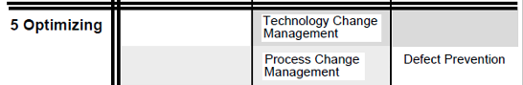
Technology Change Management
Plan & Design
Execute
Test &Procedure
Revise
Activity 1 The organization develops and maintains a plan for technology change management.
Activity 2 The group responsible for the organization's technology change management activities works with the software projects in identifying areas of technology change.
Activity 3 Software managers and technical staff are kept informed of new technologies.
Activity 4 The group responsible for the organization's technology change management systematically analyzes the organization's standard software process to identify areas that need or could benefit from new technology.
Activity 5 Technologies are selected and acquired for the organization and software projects according to a documented procedure.
Activity 6 Pilot efforts for improving technology are conducted, where appropriate, before a new technology is introduced into normal practice.
Activity 7 Appropriate new technologies are incorporated into the organization's standard software process according to a documented procedure.
Activity 8 Appropriate new technologies are incorporated into the projects' defined software processes according to a documented procedure.

Slide 28
Process Change Management
Plan & Design
Execute
Test &Procedure
Revise
Activity 1 A software process improvement program is established which empowers the members of the organization to improve the processes of the organization.
Activity 2 The group responsible for the organization's software process activities (e.g., software engineering process group) coordinates the software process improvement activities.
Activity 3 The organization develops and maintains a plan for software process improvement according to a documented procedure.
Activity 4 The software process improvement activities are performed in accordance with the software process improvement plan.
Activity 5 Software process improvement proposals are handled according to a documented procedure.
Activity 6 Members of the organization actively participate in teams to develop software process improvements for assigned process areas.
Activity 7 Where appropriate, the software process improvements are installed on a pilot basis to determine their benefits and effectiveness before they are introduced into normal practice.
Activity 8 When the decision is made to transfer a software process improvement into normal practice, the improvement is implemented according to a documented procedure.
Activity 9 Records of software process improvement activities are maintained.
Activity 10 Software managers and technical staff receive feedback on the status and results of the software process improvement activities on an event-driven basis.

Slide 29
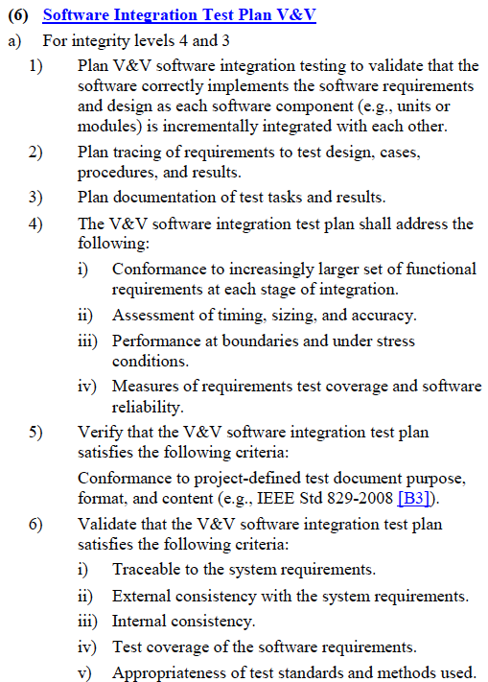
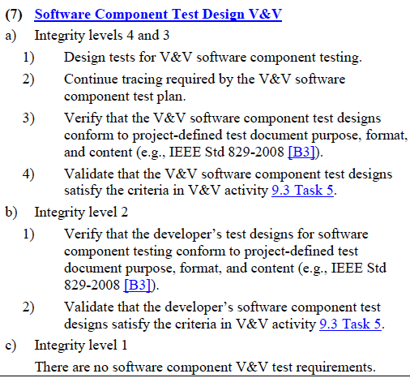
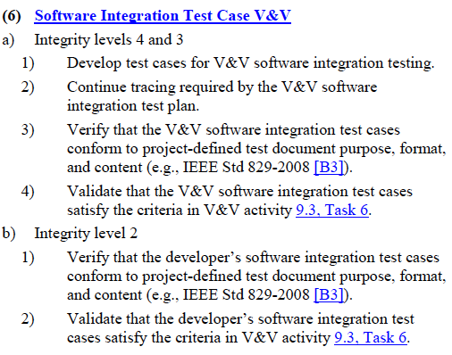
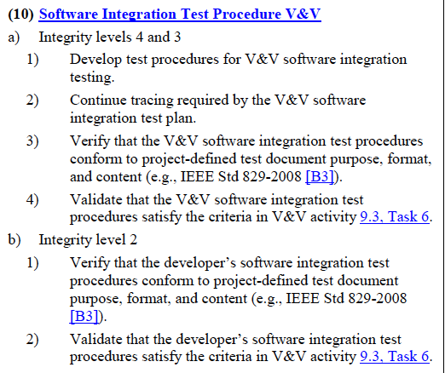
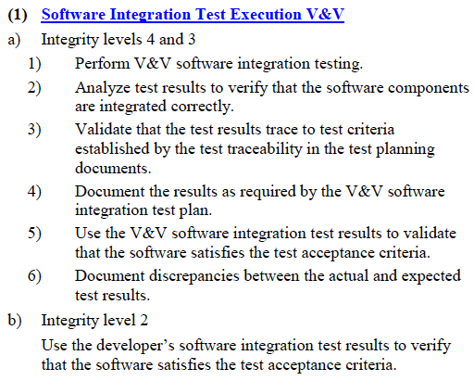
Defect Prevention
Plan & Design
Execute
Test &Procedure
Revise
Activity 1 The software project develops and maintains a plan for its defect prevention activities.
Activity 2 At the beginning of a software task, the members of the team performing the task meet to prepare for the activities of that task and the related defect prevention activities.
Activity 3 Causal analysis meetings are conducted according to a documented procedure.
Activity 4 Each of the teams assigned to coordinate defect prevention activities meets on a periodic basis to review and coordinate implementation of action proposals from the causal analysis meetings.
Activity 5 Defect prevention data are documented and tracked across the teams coordinating defect prevention activities.
Activity 6 Revisions to the organization's standard software process resulting from defect prevention actions are incorporated according to a documented procedure.
Activity 7 Revisions to the project's defined software process resulting from defect prevention actions are incorporated according to a documented procedure.
Activity 8 Members of the software engineering group and software-related groups receive feedback on the status and results of the organization's and project's defect prevention activities on a periodic basis.

Slide 30
What is involved in CMM audit?
For this week we are going to audit the IEEE 1012-2016 with the CMM Level 2-4.
Based on the V&V Process Phases from the IEEE 1012-2016 document, go through each CMM Activity listed below: CMM
Level 2
Software Quality Assurance Activities: 8
Software Subcontract Management Activities: 13
Level 3
Peer Reviews Activities: 3
Level 4
Quantitative Process Management Activities: 7
Software Quality Management Activities: 5
Level 5
Defect Prevention Activities: 8
And complete the following:
Part 1: CMM Activity Category
Identify each CMM activity (not the goal, commitment, ability). Summarize the suggested activities.
Determine which category the activity belongs:
Plan & Design
Execution
Test Case & Procedure
Revise
Part 2: CMM vs IEEE V&V
For each CMM Activity, identify one activity in the IEEE V&V process that would demonstrate that the CMM Activity is being completed.
Level 2
Software Quality Assurance
Level 3
Peer Reviews
Level 4
Quantitative Process Management
Software Quality Management
Level 5
Defect Prevention
Plan & Design
Execute
Test &Procedure
Revise

Slide 31
Plan & Design
Participate, Initiated
Prepare, Documented
Test & procedure
Collect & Documented Results
Analysis, compare
Execution
Maintained
Performed & Conduct
Review and Coordinate
Tracked, Monitor
Revise
Revision (Org. & Proj)
Feedback of Status
Measured, Baselined
Reports
Participate, Uses
Reviewed
Defined, Develop
Plan & Design
Execute
Test &Procedure
Revise

Slide 33
Verification: How does Functional Requirements (Verification) in the SW Lifecycle process?
Part 1: Make a list of all the V&V Tasking for each Process
Part 2: Understanding the workflow of the Tasking
9. Software V&V processes
9.1 Software Concept V&V process
9.2 Software Requirements Analysis V&V process
9.3 Software Design V&V process
9.4 Software Construction V&V process
9.4.3 Activities and tasks
5) Software Component Test Case V&V
6) Software Integration Test Case V&V
7) Software Qualification Test Case V&V
8) Software Acceptance Test Case V&V
9) Software Component Test Procedure V&V
10) Software Integration Test Procedure V&V
11) Software Qualification Test Procedure V&V
12) Software Component Test Execution V&V
9.5 Software Integration V&V process
9.6 Software Qualification Testing V&V process
9.7 Software Acceptance Testing V&V process
9.8 Software Verification process
9.9 Software Installation and Checkout V&V process
9.11 Software Operation V&V process
9.12 Software Maintenance V&V process
9.13 Software Disposal V&V process
Using the provided table, identify which lifecycle phase (Requirements, Design, Construction, Integration, Qualification, Acceptance) each V&V Process's phase (Plan, Design, Test Case, Procedure, Execution) is implemented.
 | V&V Process Phases
V&V Processes | Plan | Design | Test Case | Procedure | Execution
Qualification
Acceptance |  |  | i.e. Construction
Integration
Component
Which V&V Phases did not have any V&V Tasking?
Identify the difference between each of the V&V Processes (Qualification, Acceptance, Component, Integration). Why is each important?

Slide 34
Prove: Complete SQAP Section 7: Tests
 | V&V Process Phases
 | Plan | Design | Test Case | Procedure | Execution
V&V Processes
Qualification | Requirements | Design | Construction | Construction | Qualification
Acceptance | Requirements | Design | Construction | Acceptance | Acceptance
Integration | Design | Design | Construction | Construction | Integration
Component | Design | Design | Construction | Construction | Construction
Use Process to Determine the Sections and preliminary content
Component Test Plan V&V
Component Test Design V&V
Component Test Case V&V
Component Test Procedures V&V
Component Execution V&V
7 Tests
Description
7.1 Test Planning
7.2 Test Design
7.3 Test Cases
7.4 Test Procedures
7.5 Test Execution
Add more content with SQ Eng Chapter 22
1. Test Strategies
2. Test Plans
3. Test Designs
4. Software Tests
5. Tests of Supplier Component & Product (Week
6. Test Coverage Specifications
7. Code Coverage Techniques
8. Test Environments
9. Test Tools

Slide 35
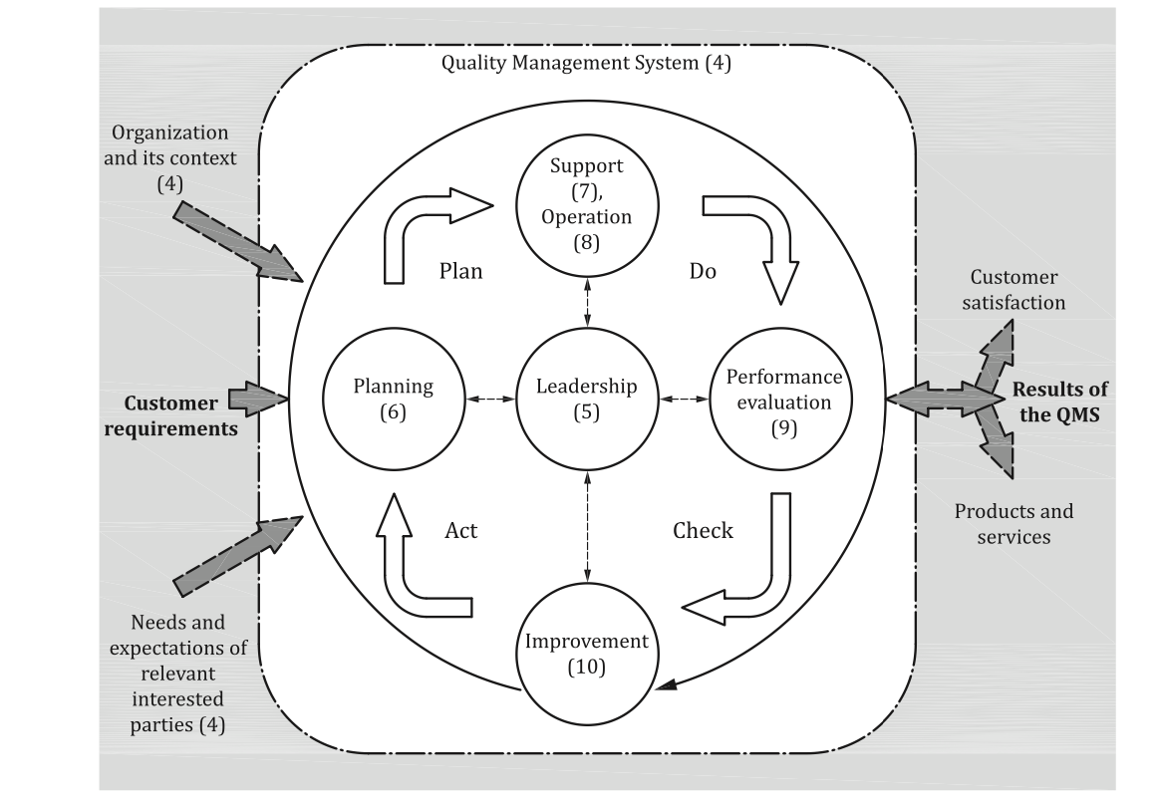
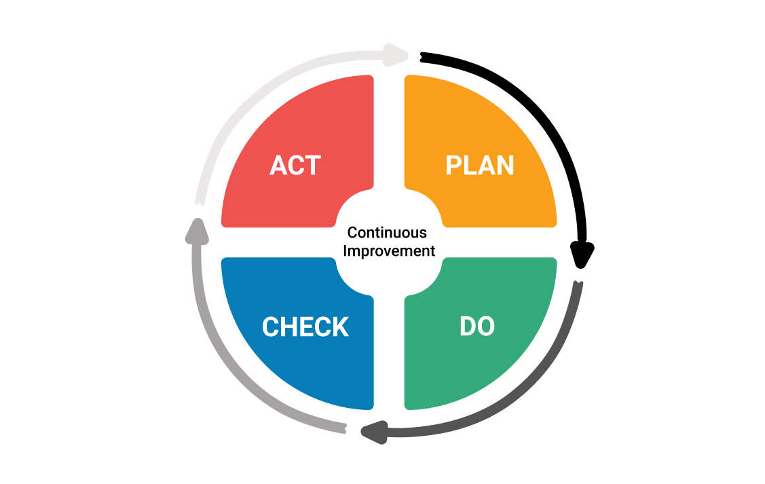
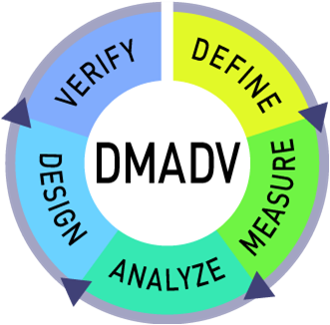
What is involved in a ISO 9001 audit?
Plan & Design
Execute
Test &Procedure
Revise
ISO 9001 and Six-Sigma are tools used to implement CMM level 4 & 5 activities and follow IEEE plans. This assignment is to discover the relational mapping of these activities.
Part 1: Compare and contrast the steps found in ISO 9001 with those found in CMM.
Using the “Plan-Do-Check-Act cycle” model, on page viii, determine which CMM activities map to
Plan: Planning(6),
Do: Support(7)/Operation(8),
Check: Performance Evaluation(9), and
Act: Improvement(10) to the model.
The model references different chapters in the rest of the document, for example Planning(6) is explain further in Section 6.
For each of the CMM Activities, choose either Planning(6), Support(7), Operation(8), Performance Evaluation(9), and Improvement(10) or neither. Explain your answer.
Level 2
Software Quality Assurance Activities: 8
Software Subcontract Management Activities: 13
Level 3
Peer Reviews Activities: 3
Software Quality Management Activities: 5
Level 4
Quantitative Process Management Activities: 7
Software Quality Management Activities: 5
Part 2: Compare and contrast the steps found in Six Sigma with those found in CMM.
Using the DMAIC model (Define, Measure, Analyze, Improve, and Control), determine which CMM activities map.
For each of the CMM Activities, choose either Define, Measure, Analysis, Improve, Control or neither. Explain your answer.
Level 4
Quantitative Process Management Activities: 7
Level 5
Defect Prevention Activities: 8

Slide 36
The key process areas at Level 2
Requirements Management p 91
Software Project Planning p 101
Software Project Tracking and Oversight p 121
Software Subcontract Management p 135
Software Quality Assurance p 153
Software Configuration Management p 165
Level 1->2: Ad Hoc to Process in place at Project Level

Slide 37
Software Quality Assurance (page 153)
Plan & Design
Execute
Test &Procedure
Revise
Activity 1 A SQA plan is prepared for the software project according to a documented procedure.
Activity 2 The SQA group's activities are performed in accordance with the SQA plan.
Activity 3 The SQA group participates in the preparation and review of the project's software development plan, standards, and procedures.
Activity 4 The SQA group reviews the software engineering activities to verify compliance.
Activity 5 The SQA group audits designated software work products to verify compliance.
Activity 6 The SQA group periodically reports the results of its activities to the software engineering group.
Activity 7 Deviations identified in the software activities and software work products are documented and handled according to a documented procedure.
Activity 8 The SQA group conducts periodic reviews of its activities and findings with the customer's SQA personnel, as appropriate.

Slide 38
What is involved in a ISO 9001 audit?
Plan & Design
Execute
Test &Procedure
Revise
ISO 9001 and Six-Sigma are tools used to implement CMM level 4 & 5 activities and follow IEEE plans. This assignment is to discover the relational mapping of these activities.
Part 1: Compare and contrast the steps found in ISO 9001 with those found in CMM.
Using the “Plan-Do-Check-Act cycle” model, on page viii, determine which CMM activities map to
Plan: Planning(6),
Do: Support(7)/Operation(8),
Check: Performance Evaluation(9), and
Act: Improvement(10) to the model.
The model references different chapters in the rest of the document, for example Planning(6) is explain further in Section 6.
For each of the CMM Activities, choose either Planning(6), Support(7), Operation(8), Performance Evaluation(9), and Improvement(10) or neither. Explain your answer.
Level 2
Software Quality Assurance Activities: 8
Software Subcontract Management Activities: 13
Level 3
Peer Reviews Activities: 3
Software Quality Management Activities: 5
Level 4
Quantitative Process Management Activities: 7
Software Quality Management Activities: 5
Part 2: Compare and contrast the steps found in Six Sigma with those found in CMM.
Using the DMAIC model (Define, Measure, Analyze, Improve, and Control), determine which CMM activities map.
For each of the CMM Activities, choose either Define, Measure, Analysis, Improve, Control or neither. Explain your answer.
Level 4
Quantitative Process Management Activities: 7
Level 5
Defect Prevention Activities: 8

Slide 39
The key process areas at Level 4
Quantitative Process Management p 299
Software Quality Management p 317
Key Process Areas - ISO 9001
Level 3->4: Process & Products are Quality Control

Slide 40
Quantitative Process Management
Plan & Design
Execute
Test &Procedure
Revise
Activity 1 The software project's plan for quantitative process management is developed according to a documented procedure.
Activity 2 The software project's quantitative process management activities are performed in accordance with the project's quantitative process management plan.
Activity 3 The strategy for the data collection and the quantitative analyses to be performed are determined based on the project's defined software process.
Activity 4 The measurement data used to control the project's defined software process quantitatively are collected according to a documented procedure.
Activity 5 The project's defined software process is analyzed and brought under quantitative control according to a documented procedure.
Activity 6 Reports documenting the results of the software project's quantitative process management activities are prepared and distributed.
Activity 7 The process capability baseline for the organization's standard software process is established and maintained according to a documented procedure.

Slide 42
Update SQAP Section 3 and 11
Section 3: Management
Section 11: Supplier control
There are four sub-section to this section: Organization, Tasking, Roles and Responsibilities, and Estimated Resources.
Organization: Identify roles found from
CMM Level 2: SW QA, Level 4: QPM, Level 5, along with ISO 9001 and Six Sigma.
Create a QA organization chart. This is different than the one you created in Week 02, and put in in week 05. Whereas the 1st chart id the project roles, this one is specific to QA roles.
Tasking: Identify different task that need to be completed.
Roles and responsibilities: Identify roles, using the previous sub-sections organizational chart, and which roles are responsible for which tasking.
Estimated Resources: This section will be completed in Week 13: Cost of Quality.
Finally cross reference your information with the IEEE 1012-2016 V&V activities.
Using CMM Level 2: Software Subcontract Management, identify the following five sections:
Supplier Provisions: Provisions for assuring that software provide by suppliers meets established requirements.
Supplier Requirements: Methods that will be used to assure that the software supplies receives adequate and complete requirements
Previous Developed Supplier Software: Id methods that will be used to assure that the software supplier receives adequate and complete requirements
New Supplier Software Development: Prepare and implement an SQAP in accordance with this standard
Supplier Compliance: State the methods to be employed to assure that the suppliers comply with the requirements of this standard
You will not find any information about subcontractor, but look for supplier.

Slide 43
Notes
PMBoK: Audits
SWEBOK: Appendix B: Software Quality
Overview of the Capability Maturity Model
ISO 9001
Six-Sigma

Slide 44

SWEBOK: Appendix B: Software Quality
IEEE Std. 90003-2008 Guide—Adoption of ISO/ IEC 90003:2004 Software Engineering—Guidelines for the Application of ISO 9001:2000 to Computer Software
IEEE Std. 730-2002 Standard for Software Quality Assurance Plans
ISO/IEC 25000 through 25099 Software Engineer- ing—Software Product Quality Requirements and Evaluation (SQuaRE)
ISO/IEC 25000:2005 Software Engineering—Soft- ware Product Quality Requirements and Evaluation (SQuaRE)—Guide to SQuaRE
ISO/IEC 25010:2011 Systems and Software Engi- neering—Systems and Software Quality Require- ments and Evaluation (SQuaRE)—System and Soft- ware Quality Models
ISO/IEC 25060 through 25064 Software Engineer- ing—Software Product Quality Requirements and Evaluation (SQuaRE)—Common Industry Format (CIF) for Usability
IEEE Std. 982.1-2005 Standard for Dictionary of Measures of the Software Aspects of Dependability
IEEE Std. 1061-1998 Standard for Software Quality Metrics Methodology
IEEE Std. 1633-2008 Recommended Practice for Software Reliability
IEEE Std. 1012-2012 Standard for System and Soft- ware Verification and Validation
IEEE Std. 1028-2008 Standard for Software Reviews and Audits
IEEE Std. 1044-2009 Standard for Classification for Software Anomalies
IEEE Std. 15026.1-2011 Trial-Use Standard Adop- tion of ISO/IEC TR 15026-1:2010 Systems and Soft- ware Engineering—Systems and Software Assur- ance—Part 1: Concepts and Vocabulary
IEEE Std. 15026.2-2011 Standard Adoption of ISO/ IEC 15026-2:2011 Systems and Software Engineer- ing—Systems and Software Assurance—Part 2: Assurance Case
ISO/IEC 15026-3:2011 Systems and Software Engi- neering—Systems and Software Assurance—Part 3: System Integrity Levels
ISO/IEC 15026-4:2012 Systems and Software Engi- neering—Systems and Software Assurance—Part 4: Assurance in the Life Cycle
IEEE Std. 1228-1994 Standard for Software Safety Plans

Slide 45
SWEBOK: Appendix B: Software Quality
One viewpoint of software quality starts with ISO 9001, Quality Management Requirements, dealing with quality policy throughout an organization.
IEEE Std. 90003-2008 Guide—Adoption of ISO/ IEC 90003:2004 Software Engineering—Guidelines for the Application of ISO 9001:2000 to Computer Software
ISO/IEC 90003 provides guidance for organizations in the application of ISO 9001:2000 to the acquisition, supply, development, operation, and maintenance of computer software and related support services.
The application of ISO/IEC 90003:2004 is appropriate to software that is
• part of a commercial contract with another organization,
• a product available for a market sector, • used to support the processes of an organization,
• embedded in a hardware product, or
• related to software services.

Slide 46
SWBok
2.3. Reviews and Audits
2.3.1. Management Reviews
The purpose of a management review is to monitor progress, determine the status of plans and schedules, and evaluate the effectiveness of management processes, tools and techniques. Management reviews compare actual project results against plans to determine the status of projects or maintenance efforts. The main parameters of management reviews are project cost, schedule, scope, and quality. Management reviews evaluate decisions about corrective actions, changes in the allocation of resources, or changes to the scope of the project.
2.3.2. Technical Reviews
The purpose of a technical review is to evaluate a software product by a team of qualified personnel to determine its suitability for its intended use and identify discrepancies from specifications and standards. It provides management with evidence to confirm the technical status of the project.
2.3.3. Inspections
The purpose of an inspection is to detect and identify software product anomalies
2.3.4. Walkthroughs
The purpose of a systematic walk-through is to evaluate a software product. A walkthrough may be conducted for the purpose of educating an audience regarding a software product.
2.3.5. Process Assurance and Product Assurance Audits
The purpose of a software audit is to provide an independent evaluation of the conformance of software products and processes to applicable regulations, standards, guidelines, plans, and procedures.

Slide 47
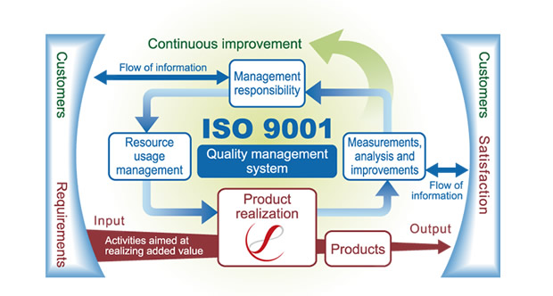
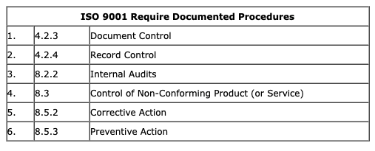
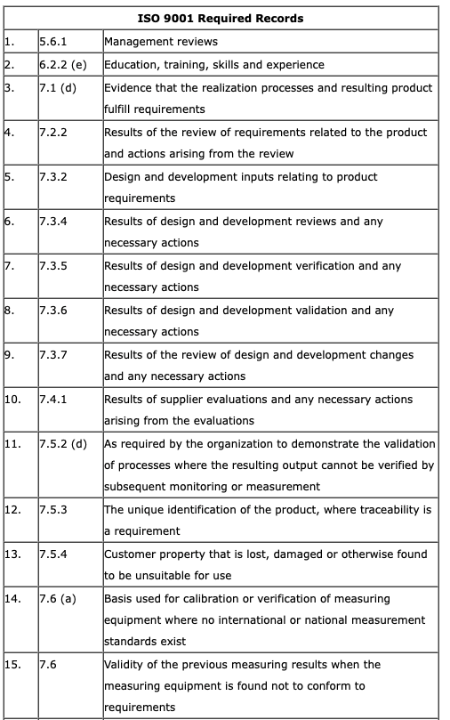
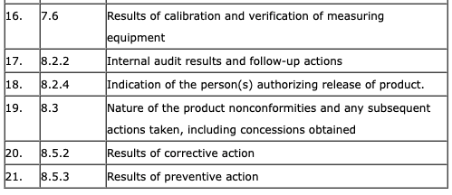
ISO 9001:2015
What is ISO 9001?
Standard to define and explain quality.
minimum requirement for ISO 9001:2008 is a quality manual, six documented procedures (I call these support processes), and 21 records
ISO 9001 doesn’t require a high level of detailed documentation.
Instead, the intent of ISO 9001 is to first accurately describe the processes which make up your business operating system and demonstrate their relationship to and interaction with one another.
The second intent is to demonstrate that your business operating system is effective at exceeding customer expectations and meeting internal business objectives.
http://www.pinnacleeg.com/iso/iso-9001-myth-2-say-what-you-do-do-what-you-say/

Slide 48
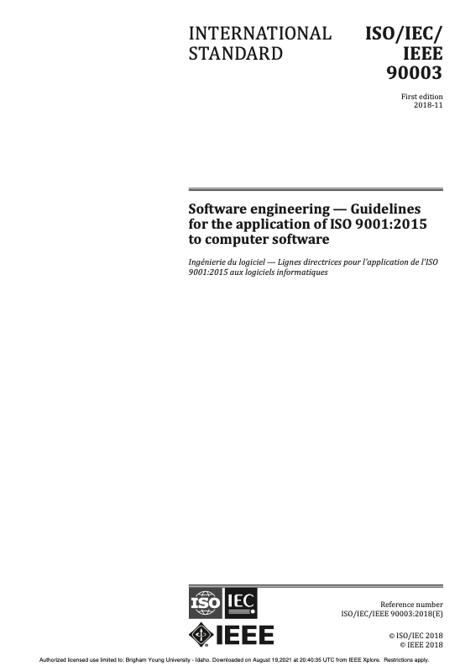
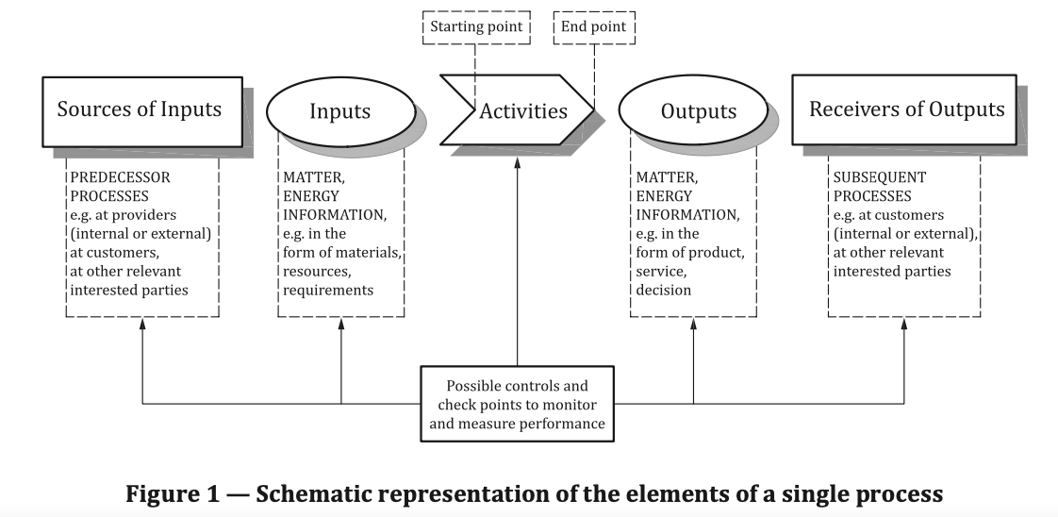
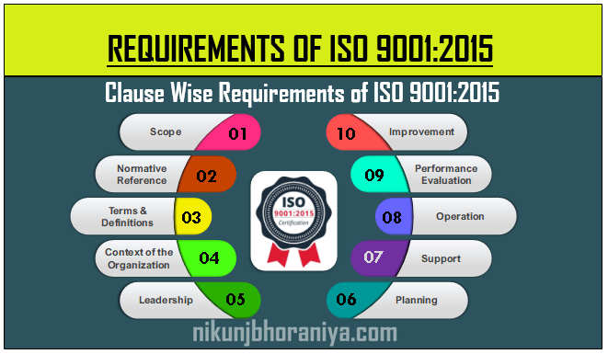
IEEE 9003-2018 Software engineering Guidelines for the application of ISO 9001:2015 to computer software
PDCA cycle description
Plan: establish the objectives of the system and its processes, and the resources needed to deliver results in accordance with customers' requirements and the organization's policies, and identify and address risks and opportunities;
Do: implement what was planned;
Check: monitor and (where applicable) measure processes and the resulting products and services against policies, objectives, requirements and planned activities, and report the results;
Act: take actions to improve performance, as necessary.

Slide 49
IEEE 9003-2018 Software engineering Guidelines for the application of ISO 9001:2015 to computer software
Leadership
5.1 Leadership and commitment
Accountability, Ensure quality policy, promoting of process approach and risk-based-thinking, quality resources are available, communication, results, effective contributions, promote improvement
5.1.2 Customer focus
5.2 Policy
5.2.1 Establishing the quality policy
5.2.2 Communicating the quality policy
5.3 Organizational roles, responsibilities and authorities

Slide 50
IEEE 9003-2018 Software engineering Guidelines for the application of ISO 9001:2015 to computer software
6 Planning
6.1 Actions to address risks and opportunities
6.1.1 Risk identification
6.1.2 Risk treatment
6.2 Quality objectives and planning to achieve them
6.2.1 Establishing quality objectives
6.3 Planning of changes

Slide 51
IEEE 9003-2018 Software engineering Guidelines for the application of ISO 9001:2015 to computer software
7 Support
7.1 Resources
7.1.1 General
7.1.2 People
7.1.3 Infrastructure
7.1.4 Environment for the operation of processes
7.1.5 Monitoring and measuring resources
7.1.5.1 General
7.1.5.2 Measurement traceability
7.1.6 Organizational knowledge
7.2 Competence
7.3 Awareness
7.4 Communication
7.5 Documented information
7.5.1 General
7.5.2 Creating and updating
7.5.3 Control of documented information
7.5.3.1 Quality management system documentation
7.5.3.2 Maintaining quality management system documentation
7.5.3.2.1 Control of data and documentation
7.5.3.2.2 Evidence of conformity
7.5.3.2.3 Retention and disposition

Slide 52
IEEE 9003-2018 Software engineering Guidelines for the application of ISO 9001:2015 to computer software
8 Operation
8.1 Operational planning and control
8.1.2 Evidence of conformity to requirements
8.2 Requirements for products and services
8.2.1 Customer communication
8.2.2 Determining the requirements for products and services
8.2.3 Review of the requirements for products and services
8.2.3.2 Maintaining requirements records
8.2.4 Changes to requirements for products and services
8.3 Design and development of products and services
8.3.2 Design and development planning
8.3.3 Design and development inputs
8.3.4 Design and development controls
8.3.5 Design and development outputs
8.3.6 Design and development changes
8.4 Control of externally provided processes, products and services
8.5 Production and service provision
8.6 Release of products and services
8.7 Control of nonconforming outputs

Slide 53
IEEE 9003-2018 Software engineering Guidelines for the application of ISO 9001:2015 to computer software
9 Performance evaluation
9.1 Monitoring, measurement, analysis and evaluation
9.1.1 General
9.1.2 Customer satisfaction
9.1.3 Analysis and evaluation
9.2 Internal audit
9.2.1 Conducting audits
9.2.2 Maintaining audit records
9.3 Management review

Slide 54
IEEE 9003-2018 Software engineering Guidelines for the application of ISO 9001:2015 to computer software
10 Improvement
10.1 General
10.2 Nonconformity and corrective action
10.3 Continual improvement

Slide 55

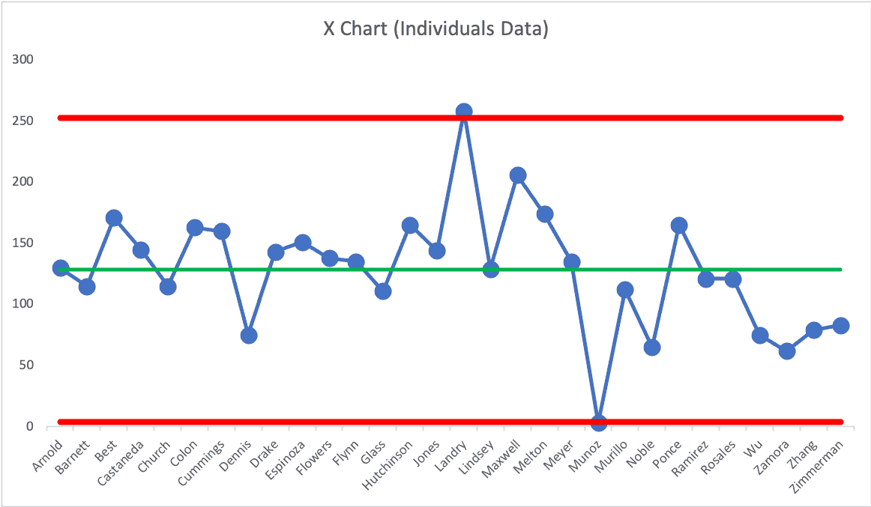
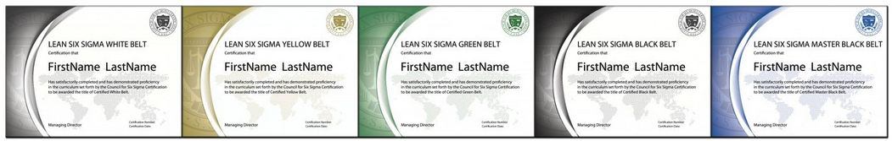
What is Six Sigma?
The Six Sigma Methodology is a set of business tools, statistical theory, and quality control knowledge that helps improve your business procedures.
It has the capability of improving performance while decreasing process discrepancy.
The methodology helps reduce defects and improve profits, and boosts both staff morale and product quality. The goal is to do away with inconsistency, waste, and defects that challenge customer loyalty.
https://www.sixsigmacouncil.org/six-sigma-training-material/

Slide 56
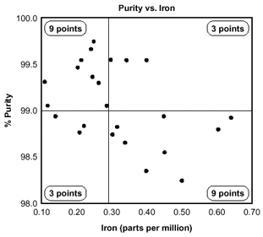

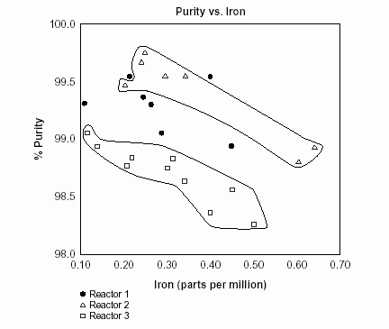
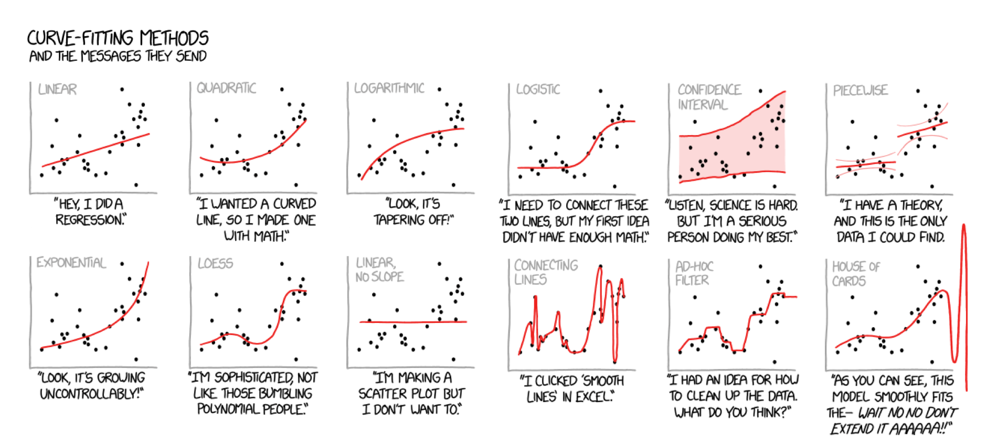
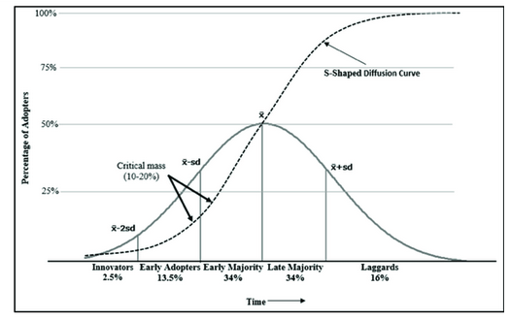
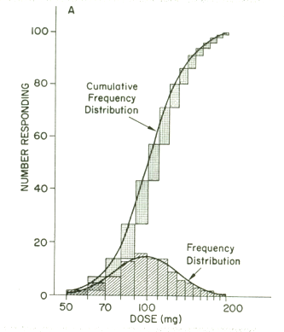
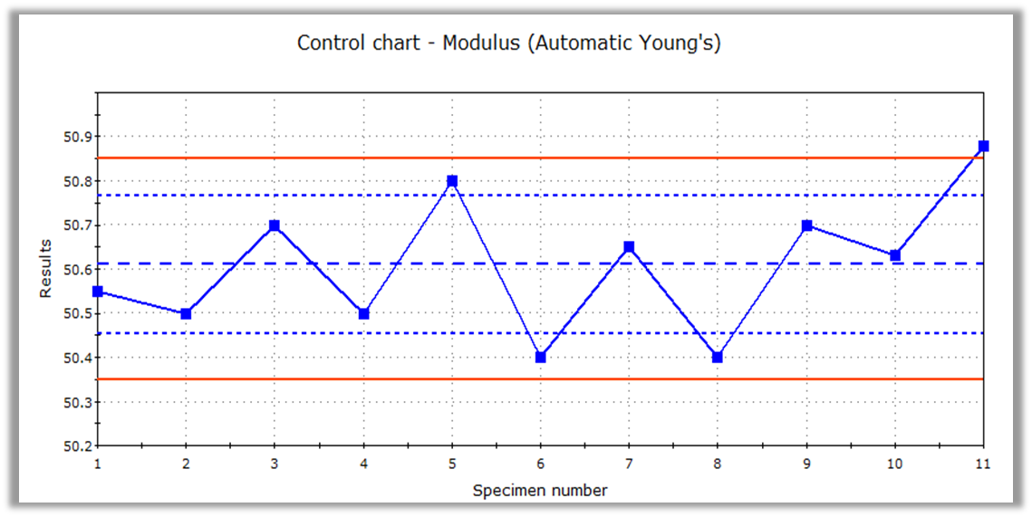
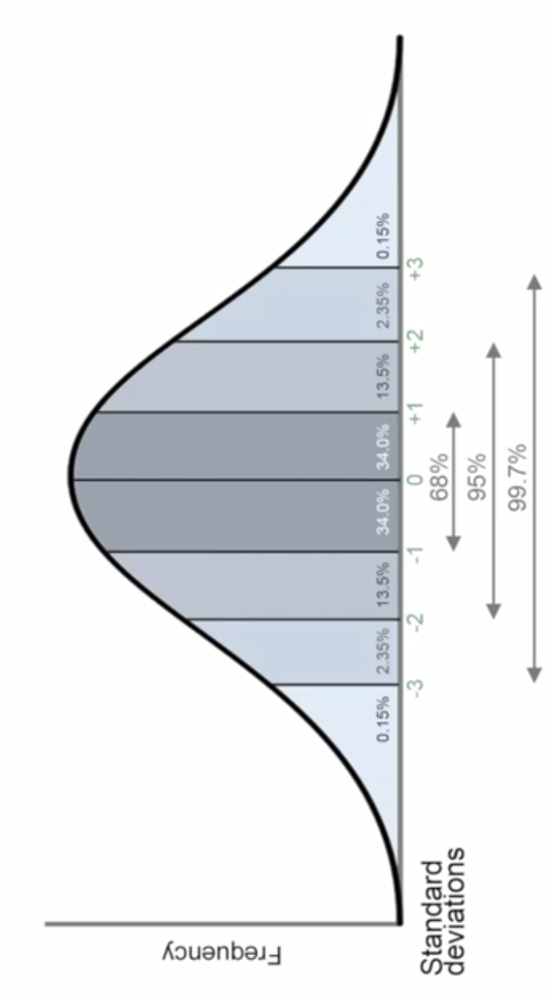


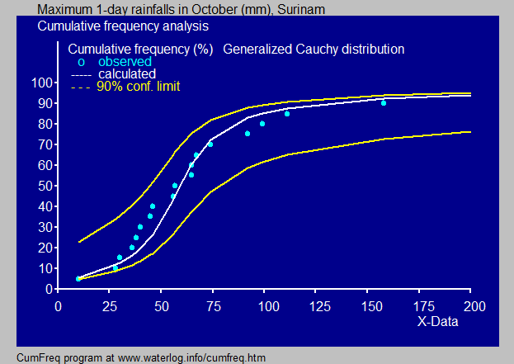

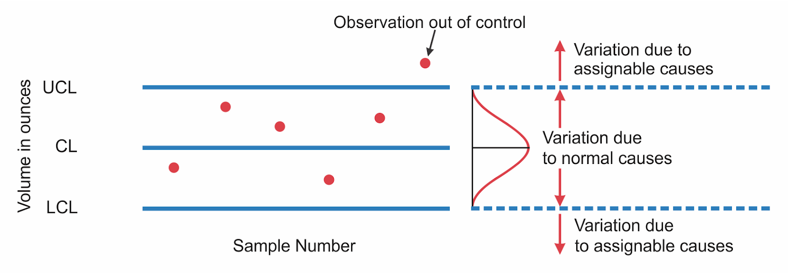
Happy Path Testing
Known path Testing
Expected Path Testing

Slide 57
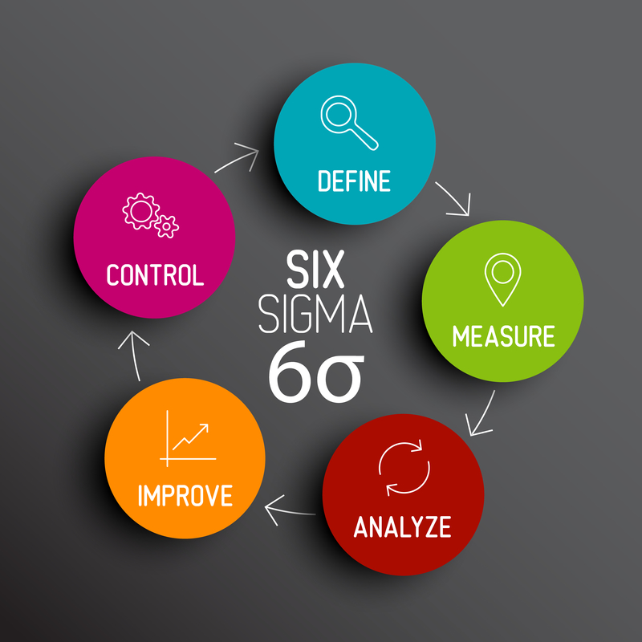
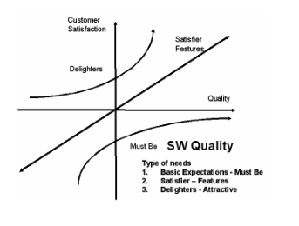
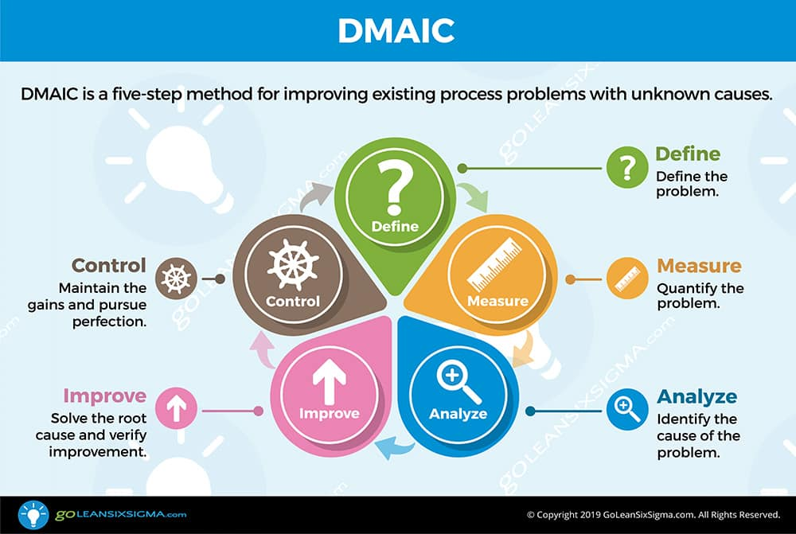
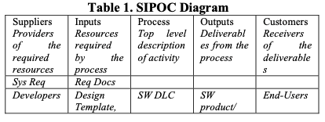



Six Sigma Approach in Software Quality Improvement
DMAIC – Define, Measure, Analyze, Improve, Control
SIPOC – Supplier, Inputs, Process, Outputs, Customers

Slide 58

CMMI and Six Sigma-Relationship & Integration
SIXSIGMA
METHODOLOGY
DMAIC
DMADV
CMMI
RELATIONSHIPS
BETWEEN CMMI PROCESS AREAS AND THE DMAIC FRAMEWORK
CMMI & SIX SIGMA: STRATEGIES
Implement CMMI process areas as Six Sigma projects
Use Six Sigma as the tactical engine for high capability and high maturity
Apply Six Sigma to improve or optimize an organization's improvement strategy and processes
Integrate CMMI, Six Sigma, and all other improvement initiatives to provide a standardfor the execution of every project throughout its life cycle.

Slide 59

ISO Compatibility
Customer satisfaction
Prevention over inspection.
Continuous improvement
Management Responsibility.
Cost of quality (COQ).

